Slide 1
Autoencoders POC Peter Chen Georgia Tech CSE678 Fall 2019

Slide 2
Anomaly detection for rare events
Problem
Detect when a system is deviating from nominal behavior and is at risk of failure using sensor data
Ex. Aircraft engine stall, fire, mechanical imbalance, vibration failure
Challenges
Lack of failure data - extreme class imbalance
Curse of dimensionality – lots of sensors
Traditional techniques may not be effective – supervised learning, classification, thresholding, rule based
Potential Solution
Semi-supervised learning using autoencoders – learn to predict nominal behavior accurately and assess reconstruction error to determine anomalies

Slide 3
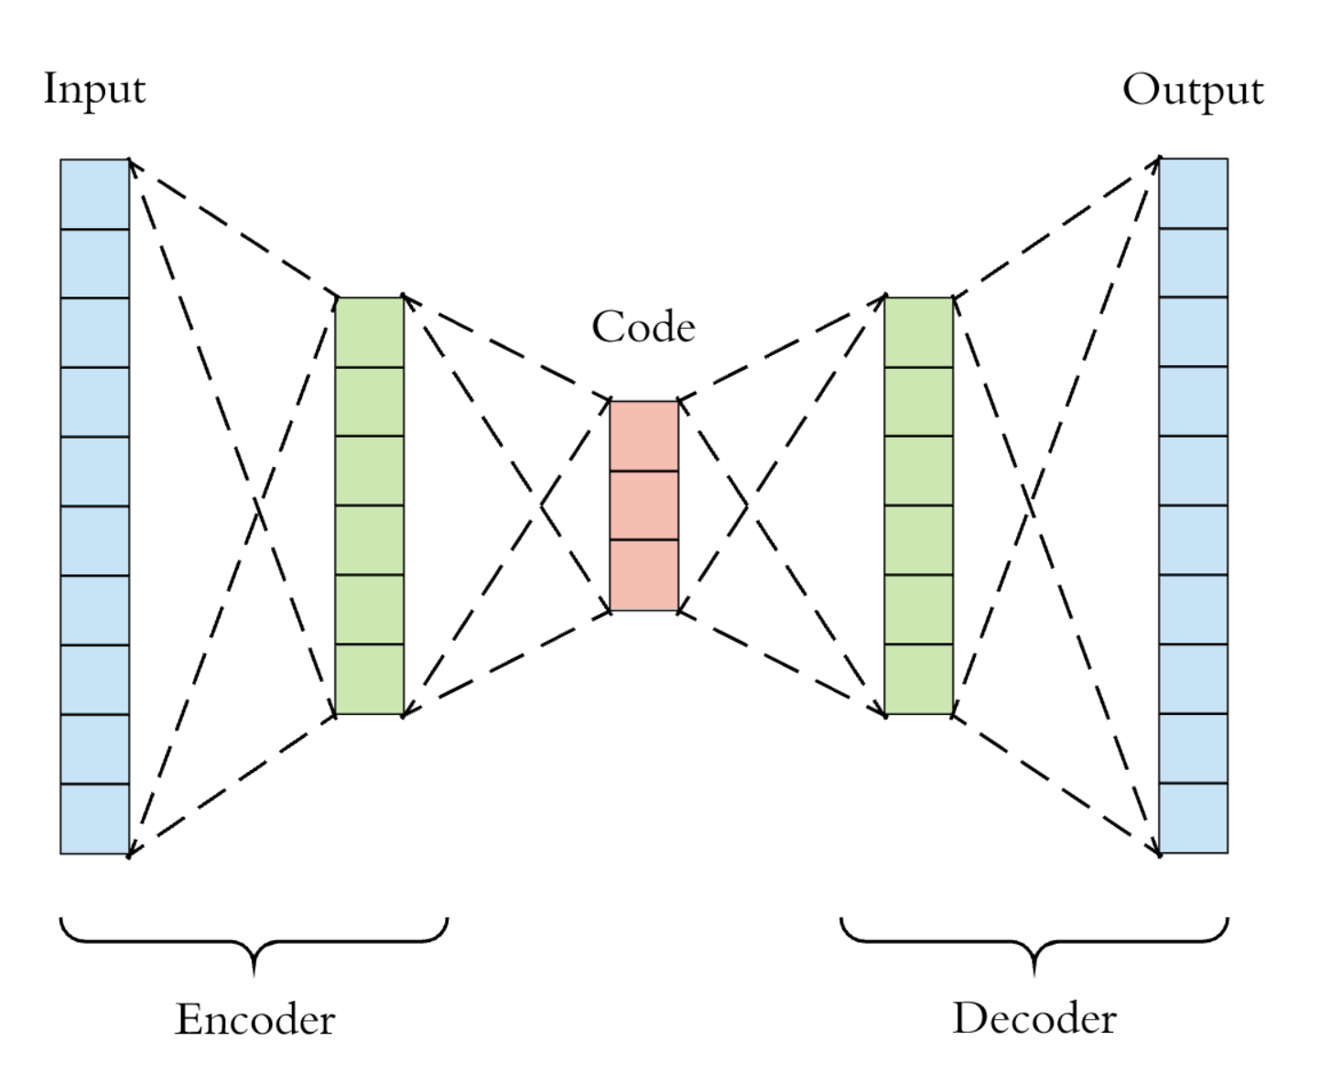
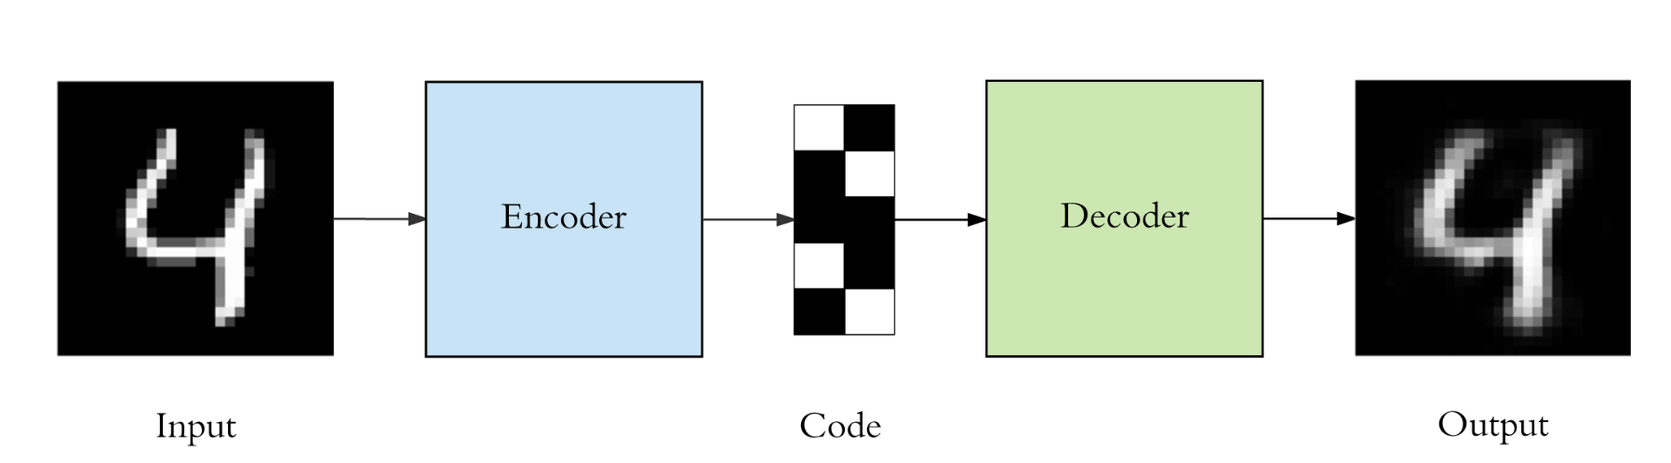
Neural Network Autoencoders
Autoencoder structure
Self-supervised learning approach
Symmetric neural network where inputs = outputs
Utilize a bottleneck layer to compress the data by reducing dimensionality
Learn a simpler representation of the data
Similar to Principal Component Analysis (PCA) with the expectation that autoencoders are non-linear
Common use case - anomaly detection, image processing, information retrieval
bottleneck
Example Use Case

Slide 4
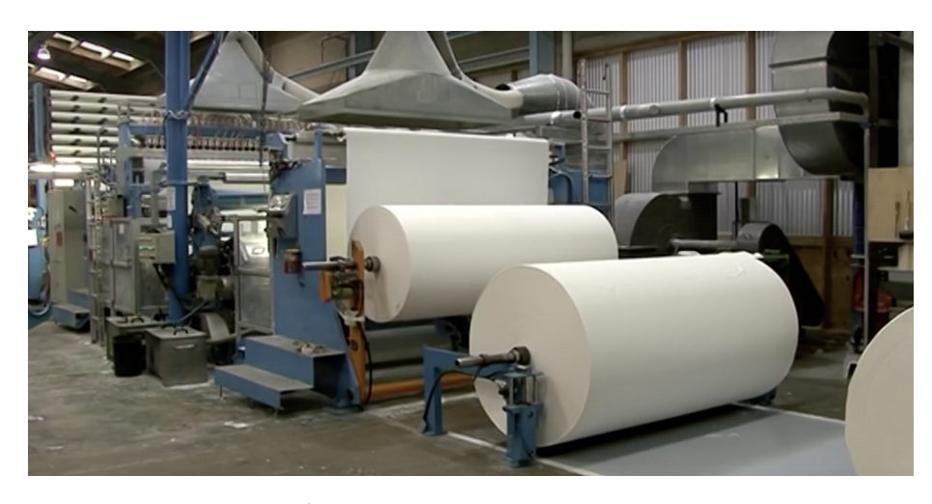
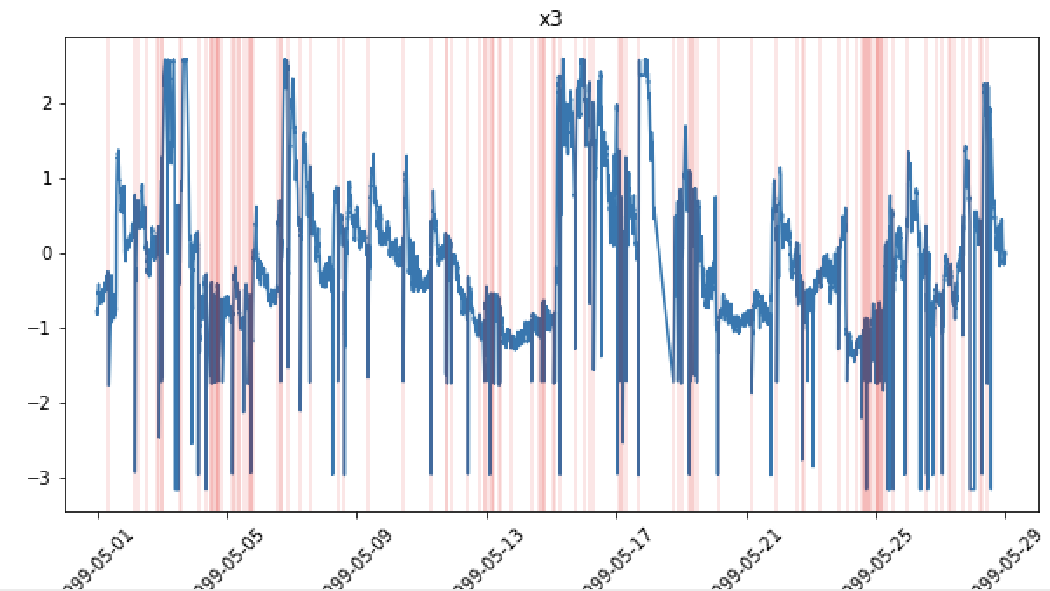
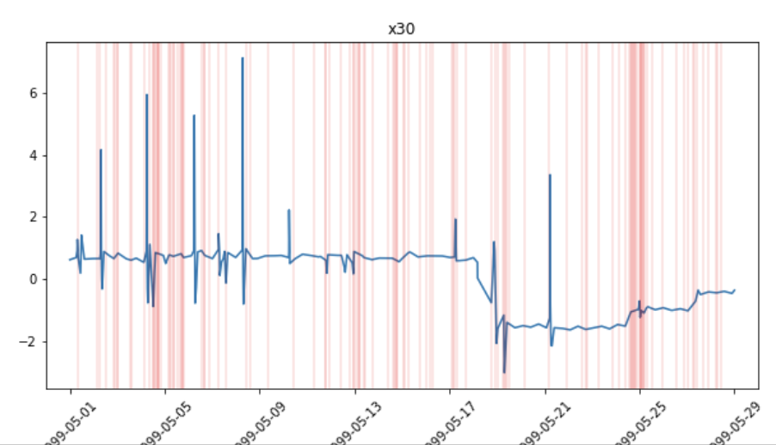
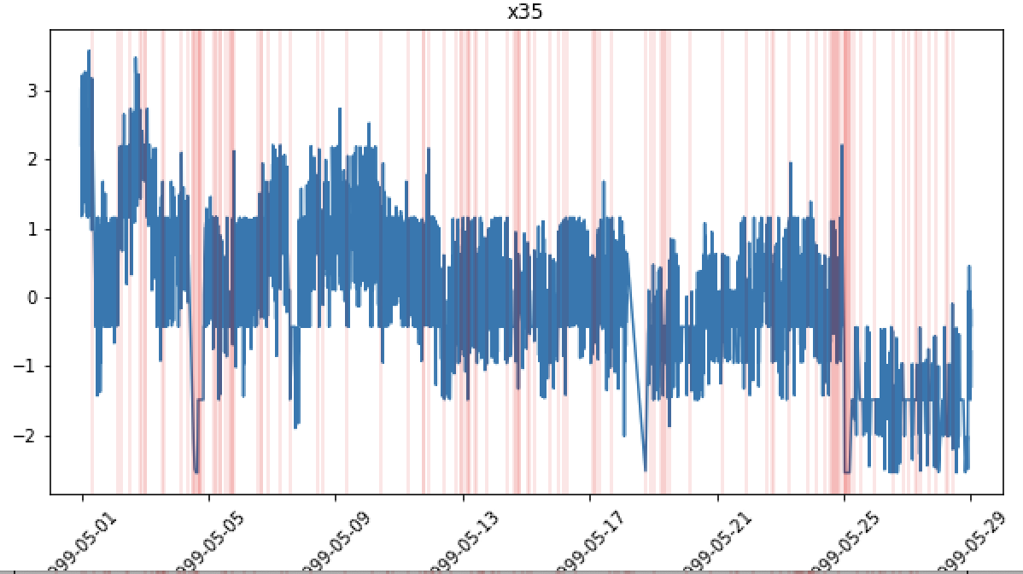
Dataset #1: Time series of Paper Mill Sensors
https://arxiv.org/pdf/1809.10717.pdf
Time series dataset of paper mill with 60 sensor parameters and 1 binary variable indicating failure and non-failures
Failures represent when the paper breaks, breaks can take over 1 hour to resolve
124 Failures are spread out throughout time dimension
~18K records over 1 month of usage (sampled every 2 minutes)
Large class imbalance – 124 failure vs 18,274 non-failure points (failures in red below)

Slide 5

Data Preprocessing – ANN
CSV file
Drop categorical variables
Pad failures
Standard scaler
Train/test split
Keep 59/61 variables
Backfill 20 timesteps prior to failure as y = 1
Use 80% of non-failures to train

Slide 6
Neural Network Regression
Anomaly Detection
Make Prediction
Calculate reconstruction error for each sensor
Average reconstruction errors
Take absolute value of avg_error
Classify anomaly based on threshold for abs avg_error
Use distribution of nominal abs avg_error and set statistical threshold
Input – 59 sensors (nominal)
Dense layer
(32 units)
Dense layer
(16 units)
bottleneck
Dense layer
(32 units)
Linear activation
Output – 59 sensors (nominal)
Batch = 12
Epochs = 150
Loss = mse

Slide 7
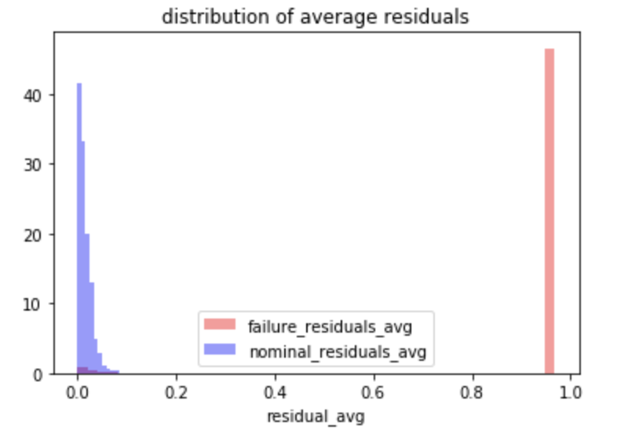
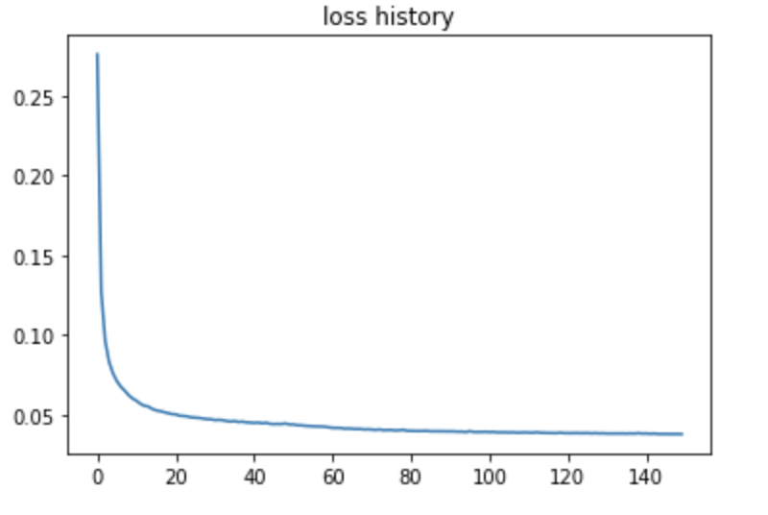
Preliminary Results
Test Set Metrics
nom
failure
3s threshold
Training Loss Curve by epoch
97% of failures points (padded by 20) exist outside of the 3sigma threshold
2197/2277 failure points
99.3% of non-failure points exist within the 3sigma abs error threshold
1597/1613 failure points
All 124 failures are caught before they happen

Slide 8
Next Steps
Find more datasets
Test different topologies
Determine way to benchmark autoencoders to other models
Apply to UTC use case

